Slide 1
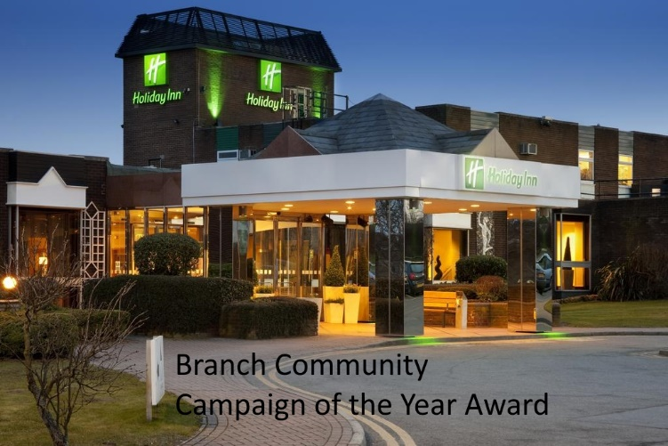

Slide 2
Seems the hard part of winning this award is how to spend the money in a way to promote more awareness of the GMB, especially as it was won for going out and getting GMB noticed with the Gazeebo which Shay Boyle our most active member does every year

Slide 3
So the idea was born for a Banner, your everyday typical Marching Banner, We had May Day coming up and the 40th year previous was a poor turn out for our area with GMB members so we thought lets try and improve for the 41st and rally up our members to turn out.
Even more so when we heard that Len McCluskey was to be a guest speaker

Slide 4
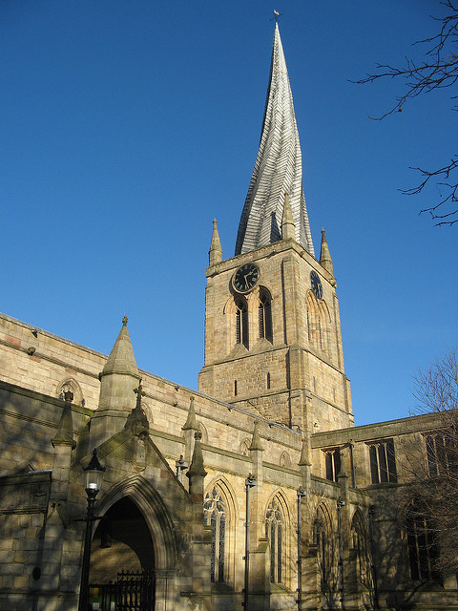
We debated around many local Landmarks, of course the famous crooked spire

Slide 5
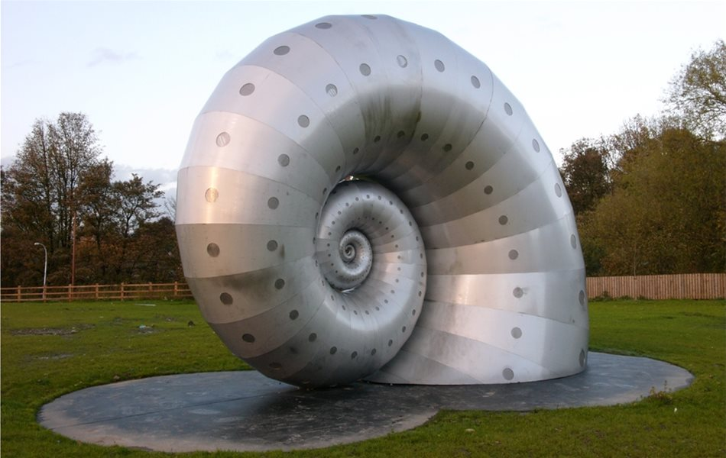
The Markham Works Snail a monument to a great steel fabricating and machine building workshop

Slide 6
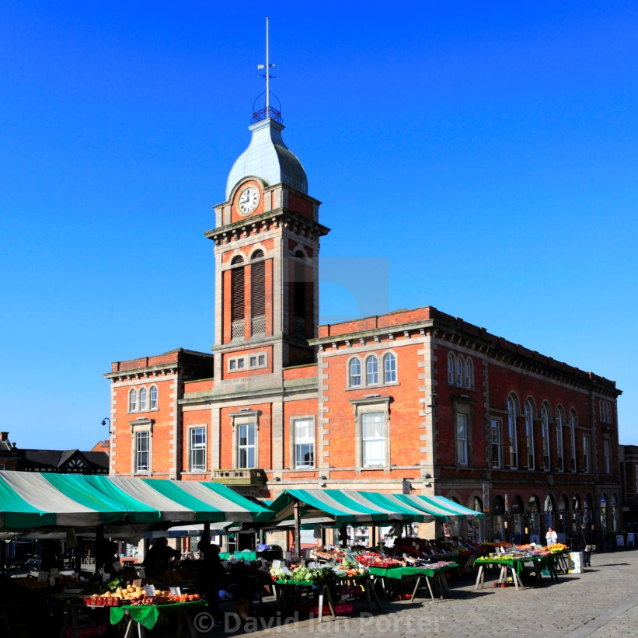
Or even the Famous Chesterfield Market known as one of the largest open air markets in England and has a rich history dating back to at least 1165

Slide 7
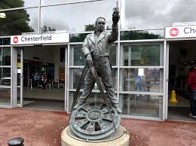
We went down the famous people route, such as George Stevenson who stands proudly outside our railway station

Slide 8
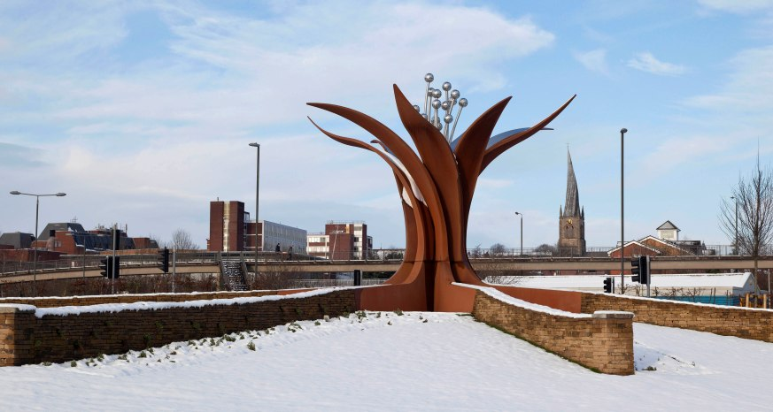
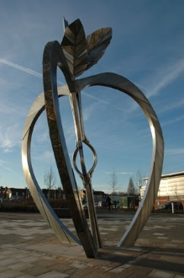
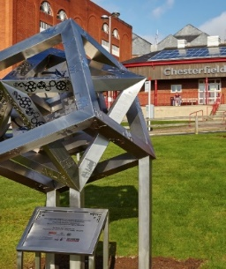
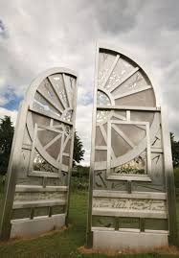
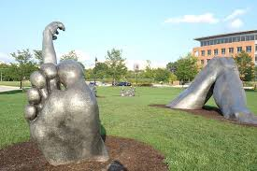
Maybe look at the new Modern Sculptures that has been erected to promote growth and welcome outsiders to Chesterfield

Slide 9
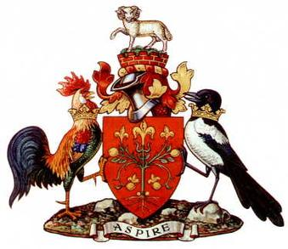
And of course how could we not consider the Chesterfield Coat of Arms
All our history rolled into one and part of another revolution

Slide 10
But we wanted something that said GMB and to be able to stand out, and
show it was for our members

Slide 11
We have members from all occupations not just the boiler makers, (even though Chesterfield Cylinders has rebuilt the boilers for HMS Sheffield.) so the banner needed to be for everyone which gave us all a headache

Slide 12
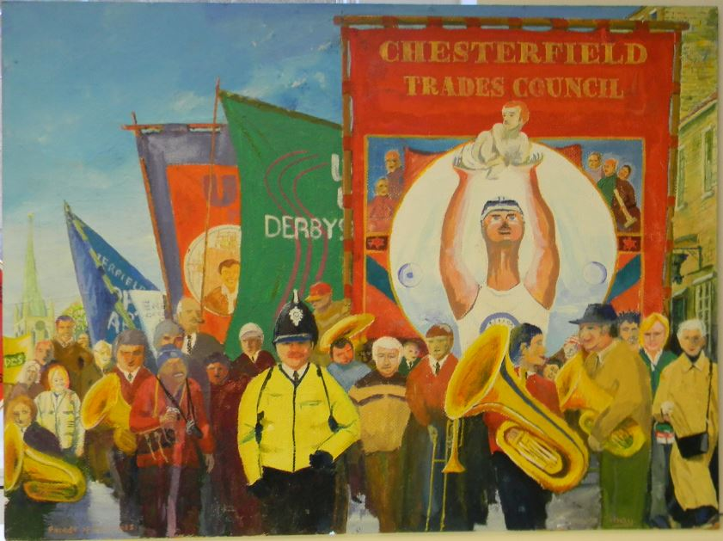
Then someone suggested the paintings that Shay Boyle himself had painted
For the front

Slide 13
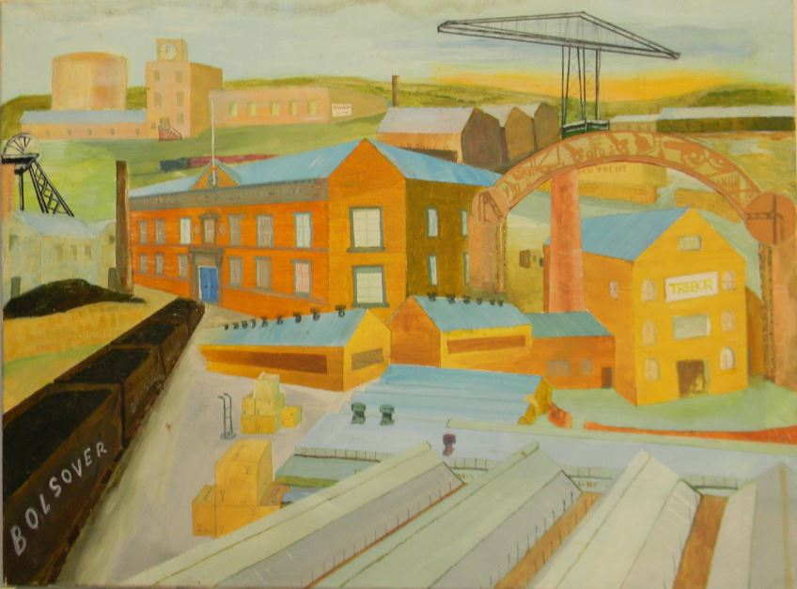
And for the rear.
These pictures have been hung in local offices around Chesterfield depicting local industry old and new in the Chesterfield area

Slide 14
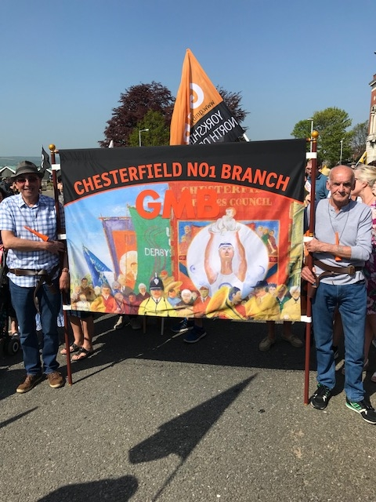
So with permission from Shay we approached Pellacraft and the banner was made ready for
May Day 2018
Bob and Paddy but not the famous TV duo

Slide 15
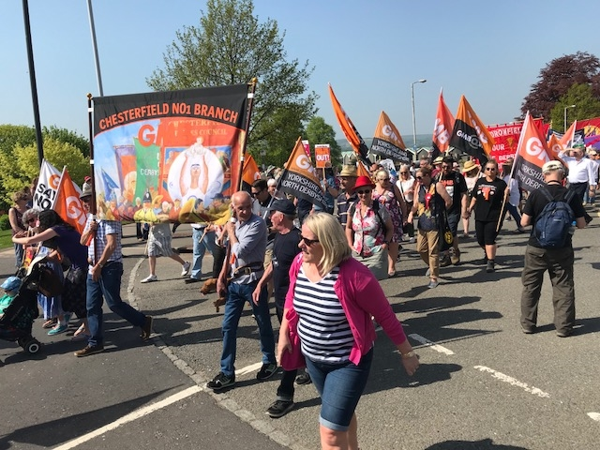
Seems to have worked and we had a very good turn out from GMB members

Slide 16
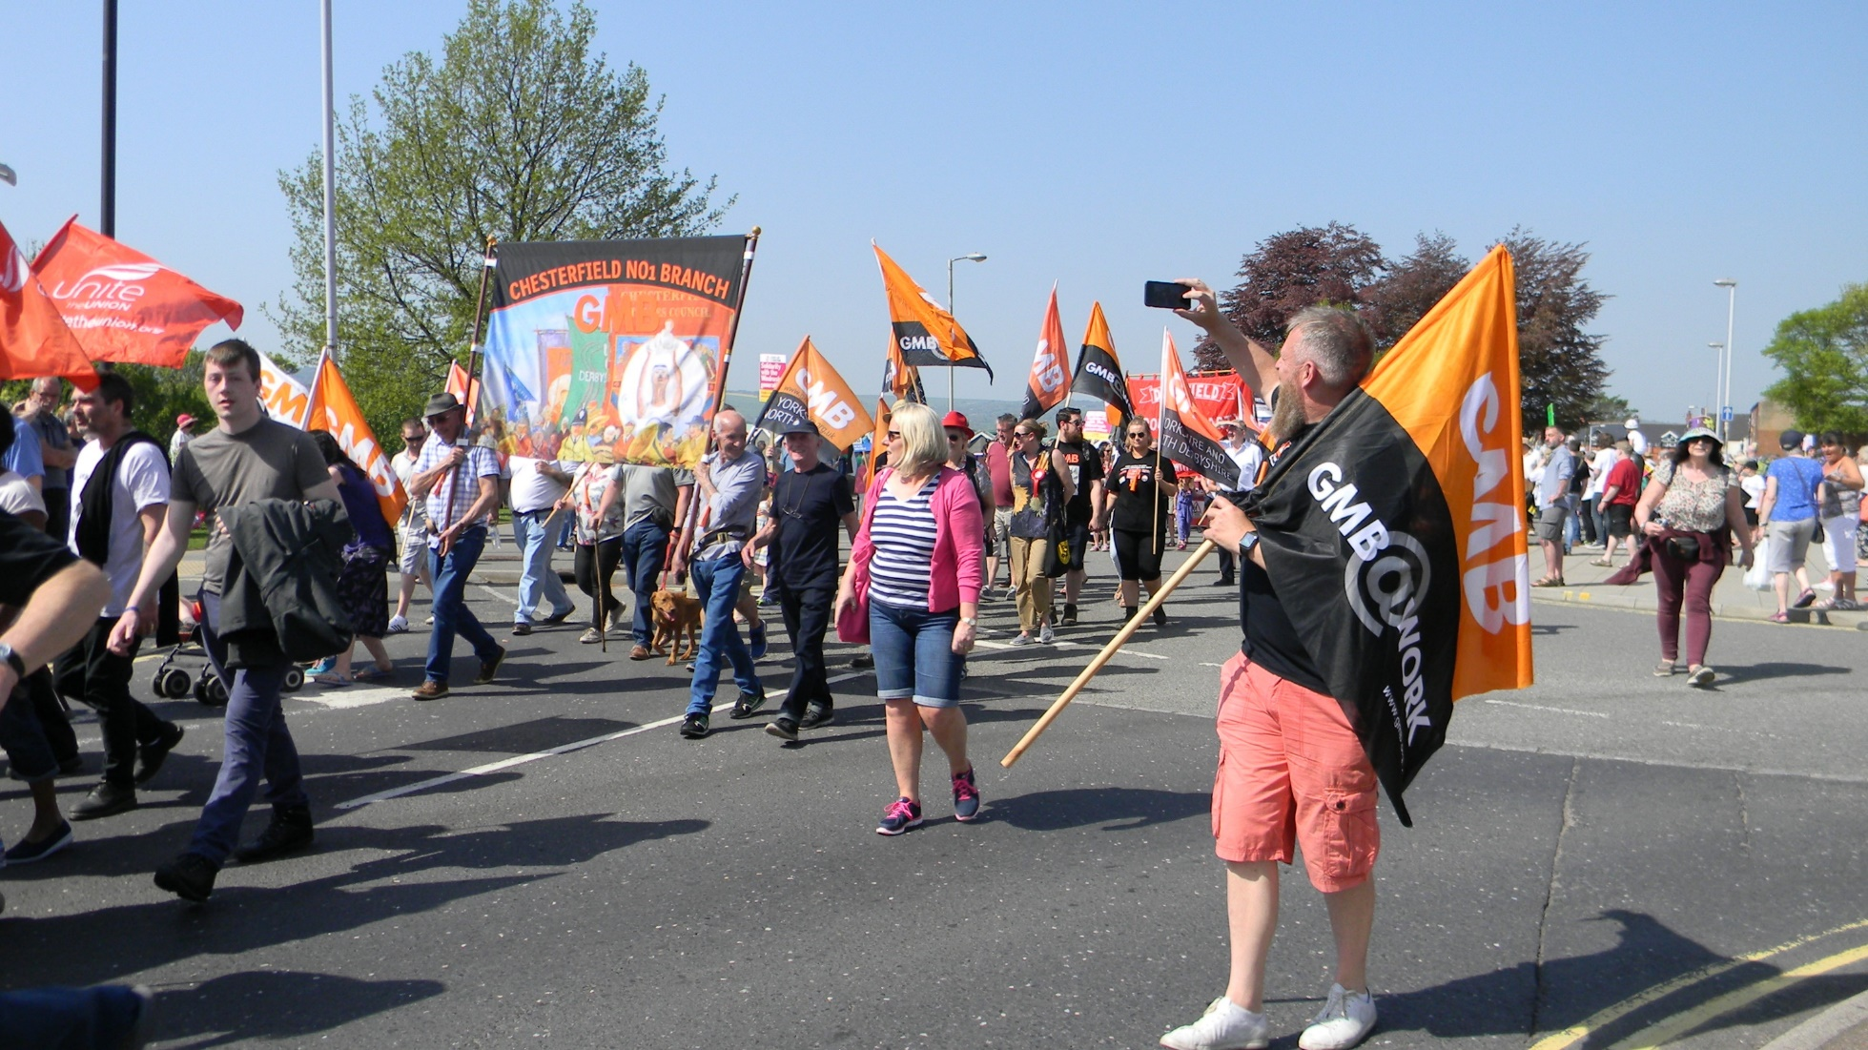

Slide 17
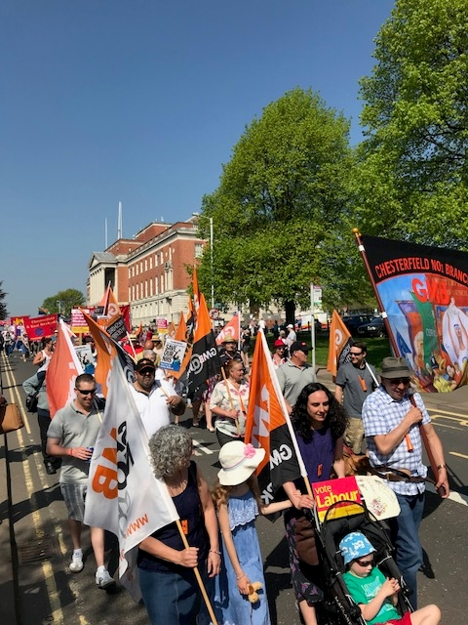
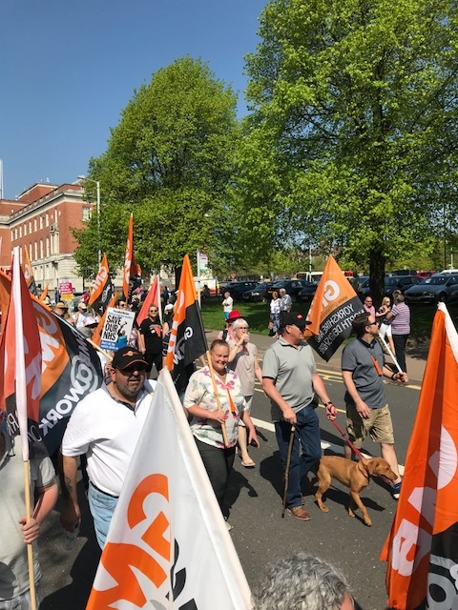

Slide 18
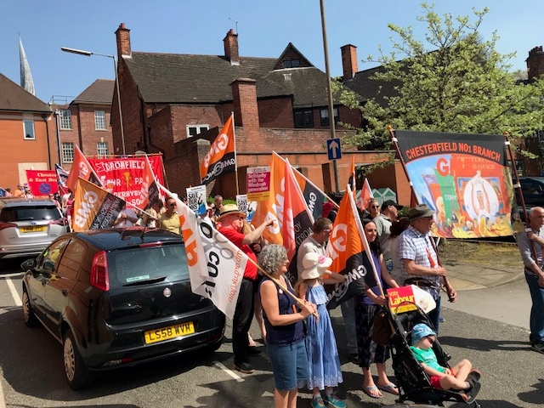

Slide 19
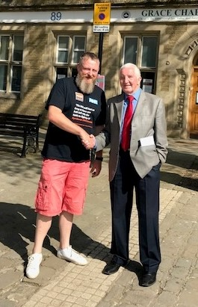
Even the
Beast of Bolsover
the one and only
Dennis Skinner was tempted out
(could have been the sunny weather)
Note the shorts on the other guy
The Beast of Chesterfield

Slide 20
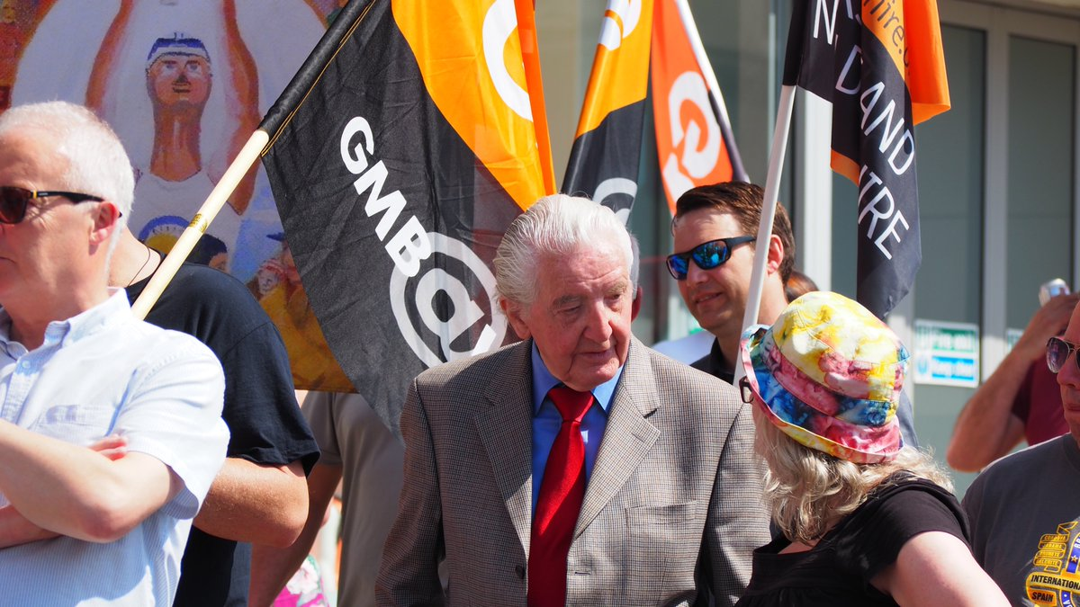
Proof he did march

Slide 21
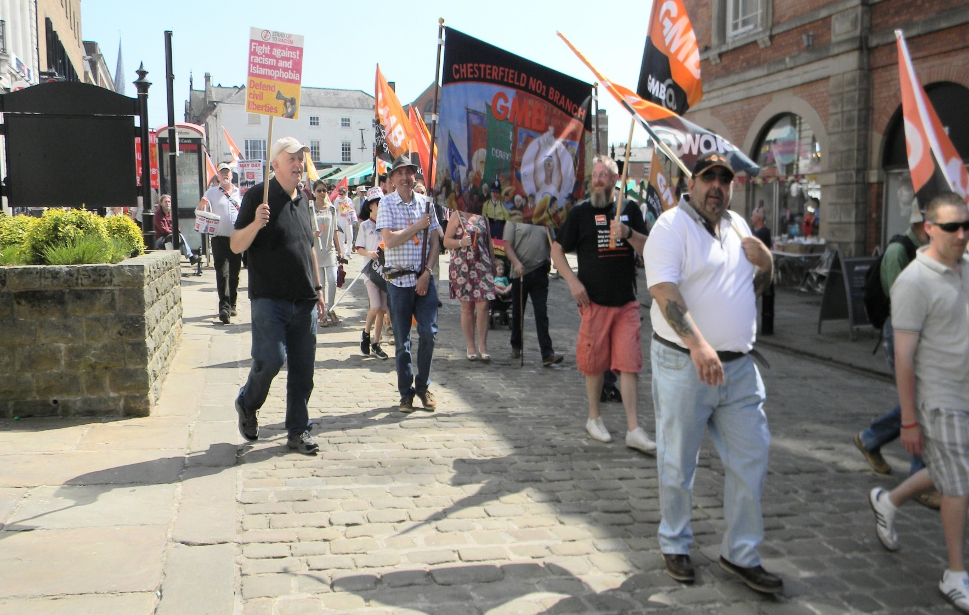

Slide 22
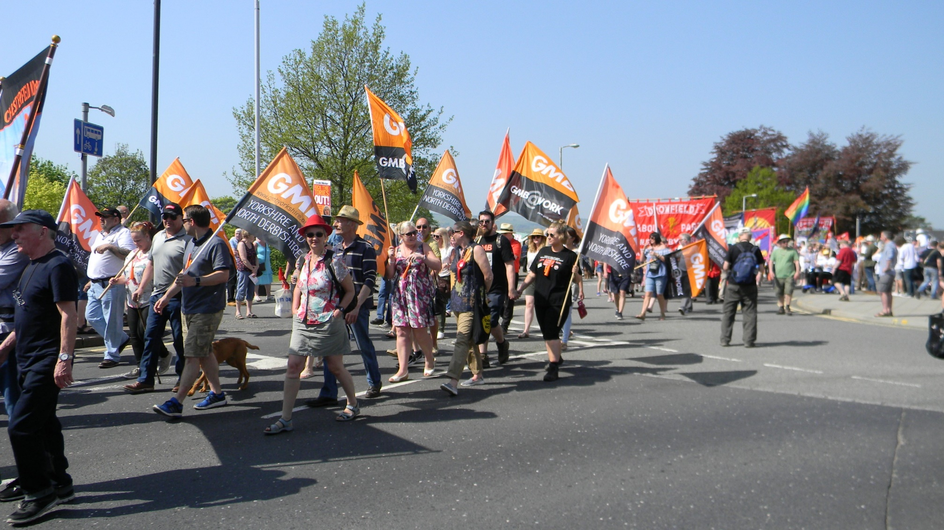

Slide 23
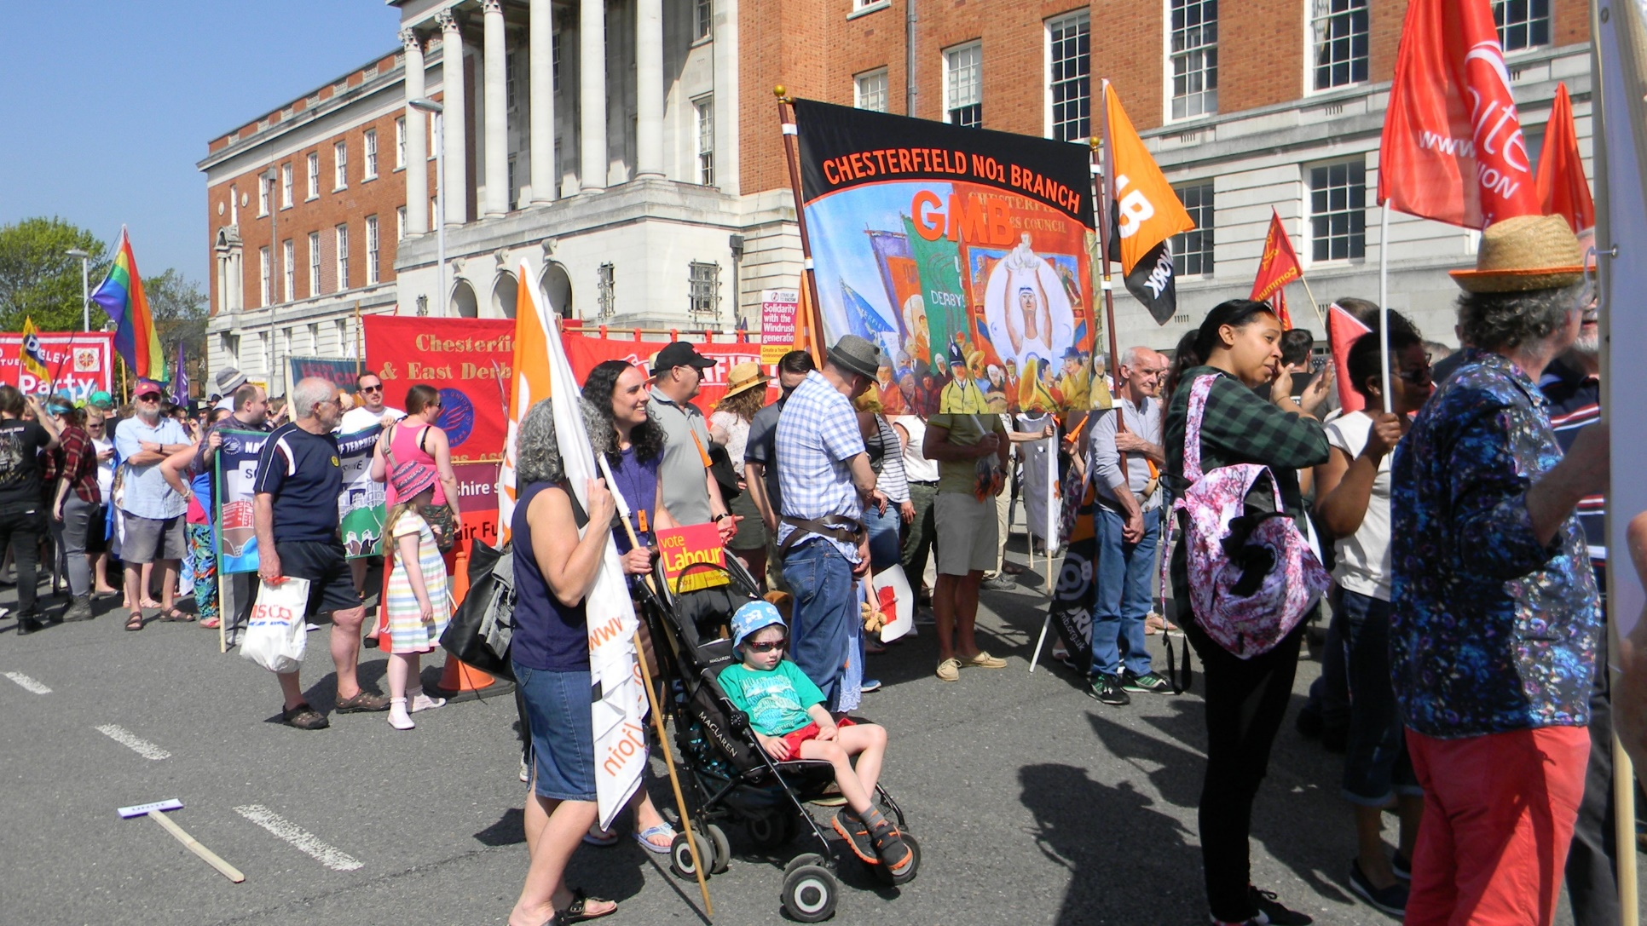

Slide 24
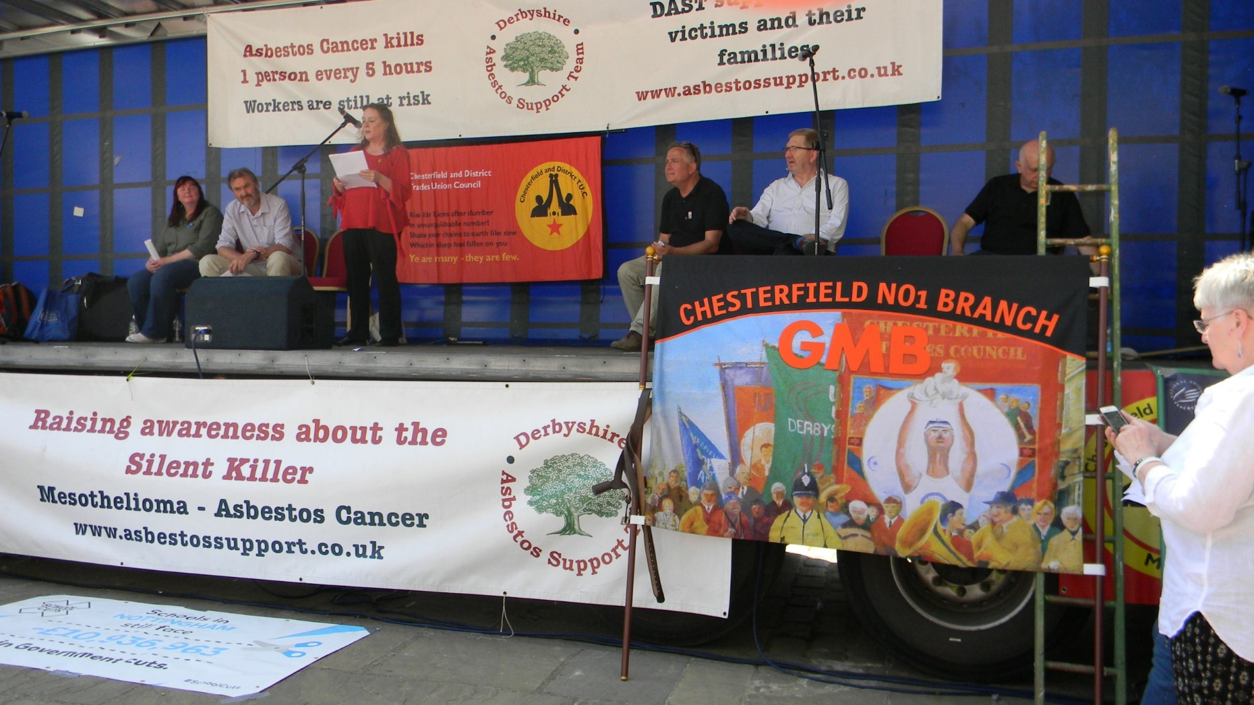
Sitting Mr McCluskey on our banner

Slide 25
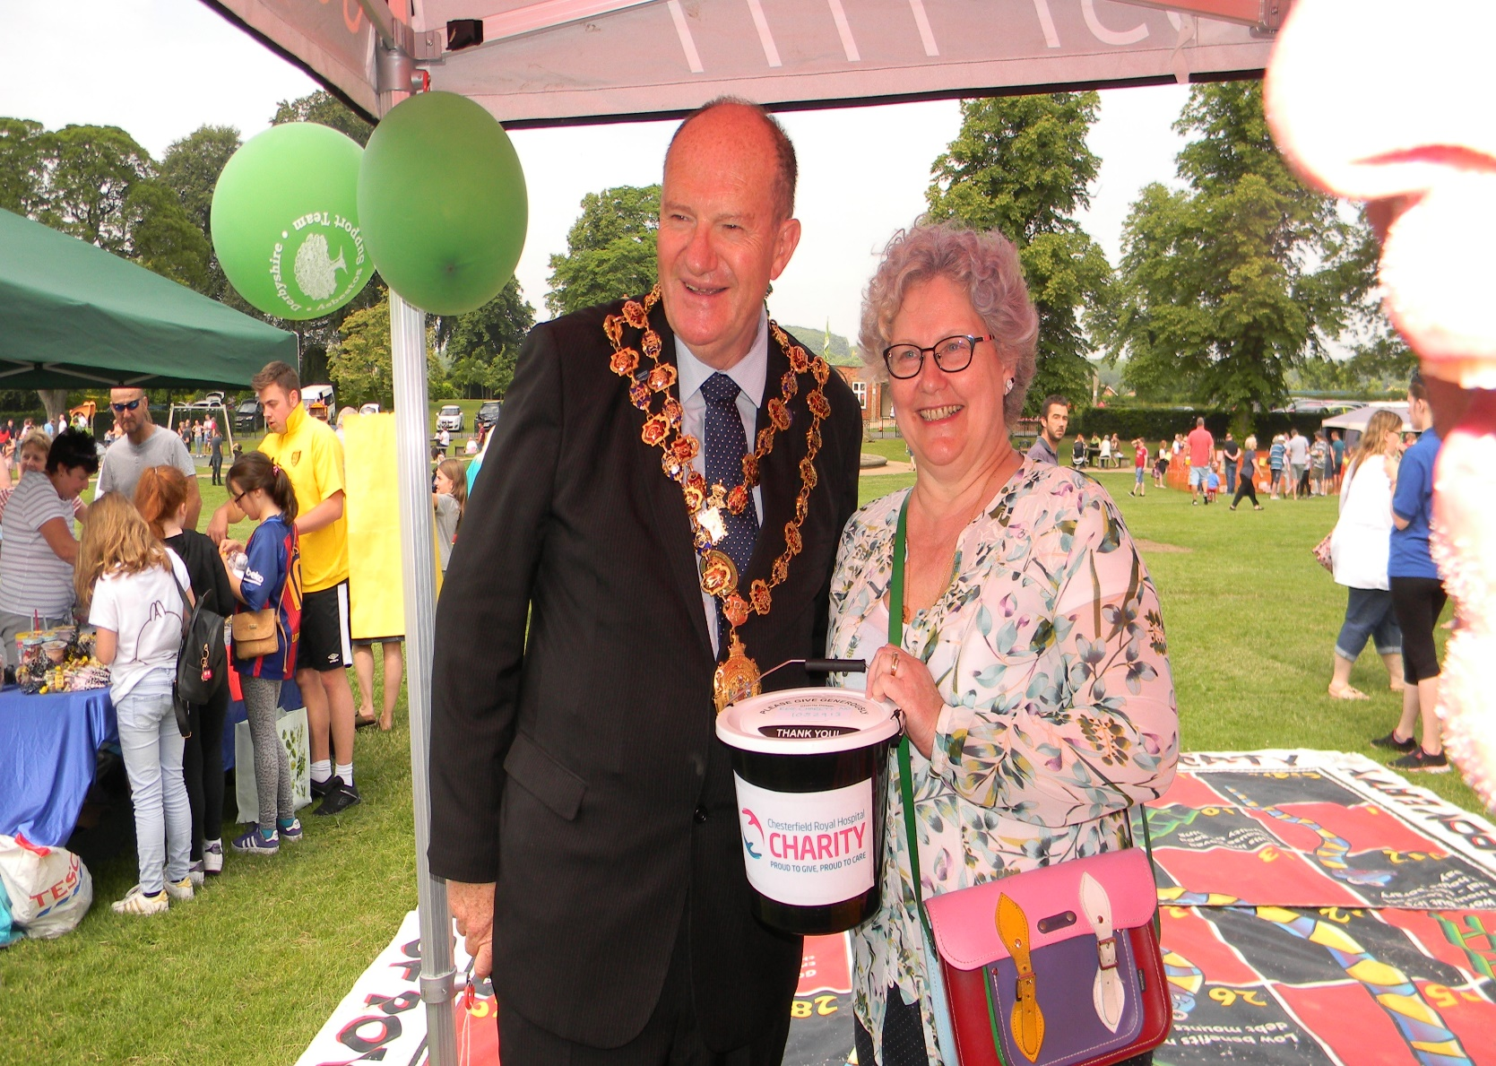
These next slides are from Shays many outings promoting GMB and assisting others with the GMB Gazebo

Slide 26
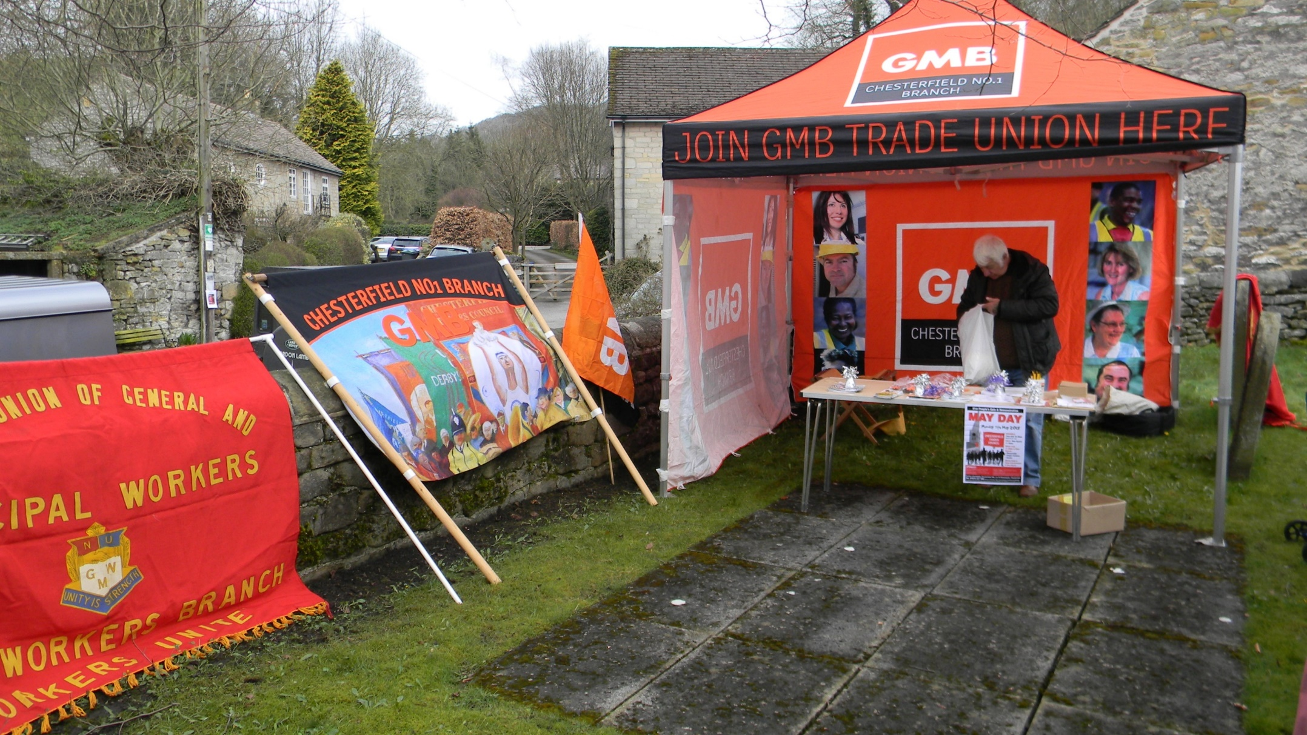

Slide 27
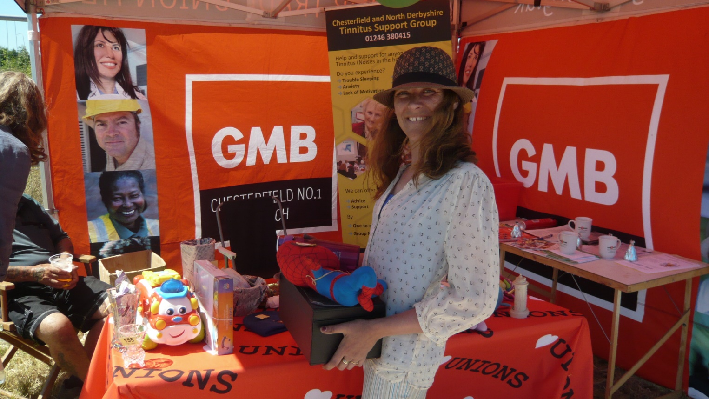

Slide 28
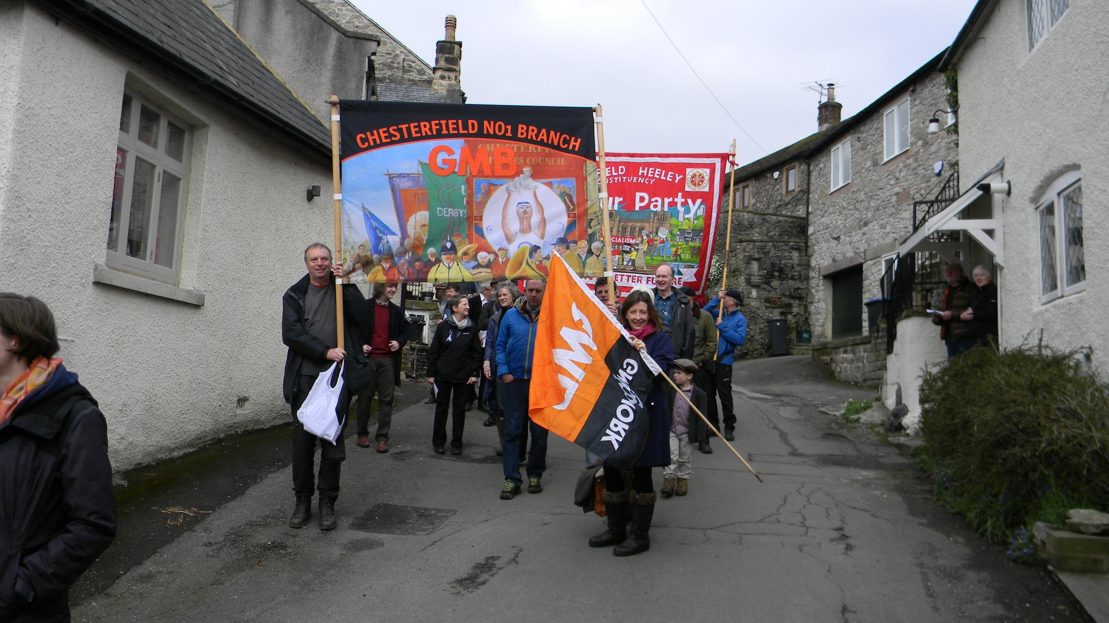
And Finally
What it was made for “Marching for the Tolpuddle Martyrs”

Slide 29
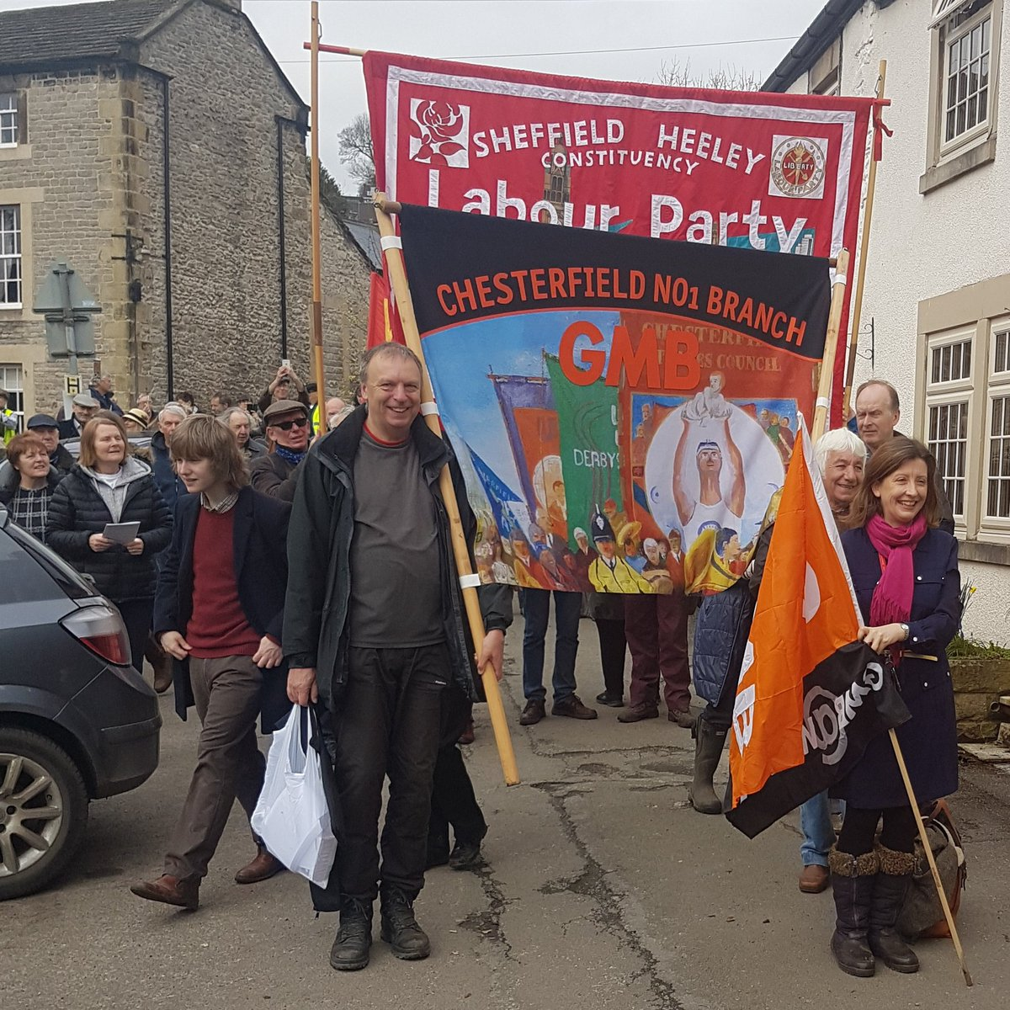
Who knows where we could be marching this year, no matter where we are ready

Slide 30
